Slide 1


Conditional Probability
AC52012: Research Methods
Notes:
In this video, we are going to talk about the concept of conditional probability, followed by the different ways to count the number of elements in a large sample space. As a brief overview, I’ll start by introducing the concept of two-part experiments and relate that to the concept of conditional probability. Then I’ll introduce another very important rule related to conditional probability, which is called the multiplication rule. Then I’ll finish with variations, permutations, and combinations, which are different methods of counting elements in a sample space.

Slide 2
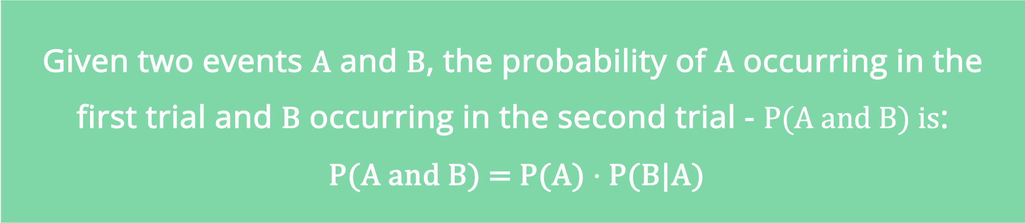
CONDITIONAL PROBABILITY
Conditional probability of events A and B, denoted by P(B|A) is the probability that event B occurs after assuming event A occurred.
THE MULTIPLICATION RULE
Given two events A and B, the probability of A occurring in the first trial and B occurring in the second trial - P(A and B) is:
P(A and B) = P(A) $⋅$ P(B|A)
Notes:
In two-part experiments, we run two trials (which may be unrelated) and we’re interested in whether an event in the second trial might be conditional on an event occurring in the first trial. This is the basis of conditional probability – we want to know the probability of event B taking place given that event A has already taken place.
If the outcome of event A somehow affects the probability of event B, it’s important to adjust the probability of B to reflect the occurrence of event A. The rule for finding P(A and B) which is the probability that event A occurs AND event B occurs is called the multiplication rule. This is because it involves the multiplication of the probability of event A and the probability of event B (adjusted because of the outcome of event A).
In English, we multiply the probability of event A by the probability of event B, but being sure that the probability of event B takes into account the previous occurrence of event A.

Slide 3
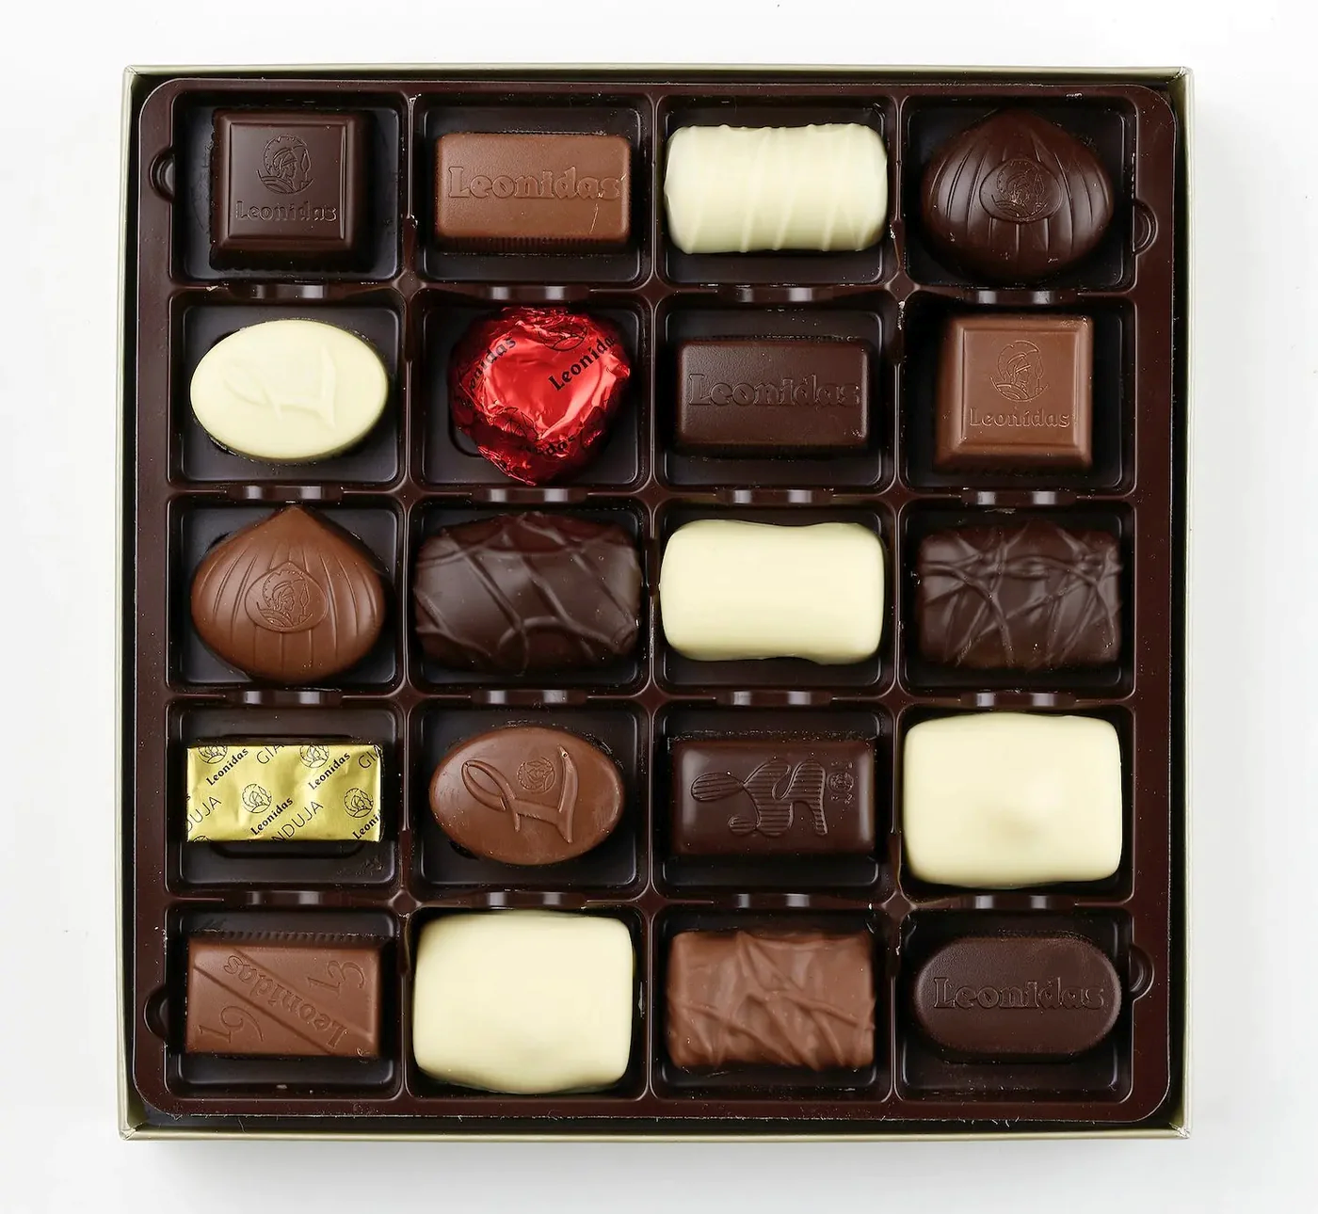
BACK TO SAMPLING
Sampling with replacement: Selections are independent events
Sampling without replacement: Selections are dependent events
Rule of thumb: When population is large enough and the sample size is no more than 5% of the population, we can treat selections as independent even if we do sampling without replacement.
Notes:
Coming back to sampling and population, when we do ‘sampling with replacement’ this means that our selections are independent events. Conversely, when we sample ‘without replacement’ our selections are dependent events.
Let’s say we have this box of chocolates on the slide – I close my eyes and pick one at random. Let’s say it’s one of the white ones. Now if I do the same again without putting the white one back, this then affects the probability of my future choices – the probability of selecting a white one has lowered, whereas the probability of selecting the dark, milk, or wrapped ones has increased slightly.
If I put the chocolate back before sampling again, then subsequent samples are not affected by the previous event. That is, they’re independent.
Sampling without replacement can lead to some complex calculations, and so as a rule, when our population is large enough, and we’re not drawing more than 5% of it as our sample, we can treat the sampling as independent. So if this box had 100 chocolates in it and I took, say, four of them, the impact of me not replacing them is very unlikely to skew the sample.

Slide 4


EXAMPLE COMPLICATIONS
Suppose we have a bag with 10 red balls and 10 blue balls mixed. We draw two random balls from the bag. What is the probability that both balls will be red if…
1. we draw the first ball, then return it into the bag, then draw the second ball?
2. we draw the first ball, put it aside, and then draw the second ball?
Notes:
Let’s have a look at where sampling without replacement can lead to complications. As a simple example, we have a bag with 10 red balls and 10 blue balls. We close our eyes and draw a ball at random from the bag. We have two situations – we can either return the ball to the bag and then draw another one, or we can put the ball we’ve drawn aside before drawing another one.
So what’s the probability of both balls being red in these two situations?

Slide 5


EXAMPLE COMPLICATIONS
1. we draw the first ball, then return it into the bag, then draw the second ball?
independent events
P(A and B) = P(A) · P(B|A) = P(A) · P(B) = $\frac{10}{20} ⋅ \frac{10}{20}=\frac{1}{2}⋅\frac{1}{2}=\frac{1}{4}=0.25$.
2. we draw the first ball, put it aside, and then draw the second ball?
dependent events
P(A and B) = P(A) · P(B|A) = $\frac{10}{20} ⋅ \frac{9}{19}=\frac{9}{38} ≈0.237$.
Notes:
In the first case, the events are independent, because in both cases we have the same number of balls of the same type in the bag and each time we draw a ball randomly. Therefore, the probability of drawing two red balls is just the probability of drawing a red ball multiplied by itself. In the notation, P(B|A) is just P(B) because B doesn’t care whether A did or did not happen. This means that the probability is 1 in 4, or 0.25
In the second case, the events are now dependent because when we draw a second ball, we will have one ball fewer in the bag (as we have put the ball we drew in the first event aside). P(A) is still 10/20 = 1/2, because event A happened when there were 20 balls in the bag, but the probability P(B|A) is now 9/19 (since if the first ball drawn is red, there are 19 balls left in the bag, 9 of which are red and 10 of which are blue). This means that our probability of drawing two red balls is 10/20 * 9/19, which is roughly 0.237 – slightly smaller. Note that we don’t care about the probability of P(B|A) if the first ball drawn is blue, because then P(A) would be 0 and so the whole P(A and B) would also equate to 0.

Slide 6
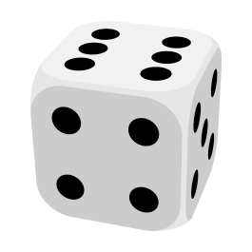
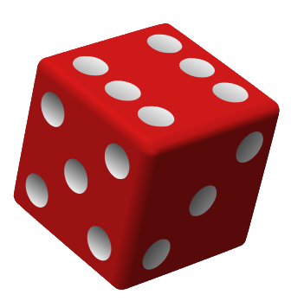
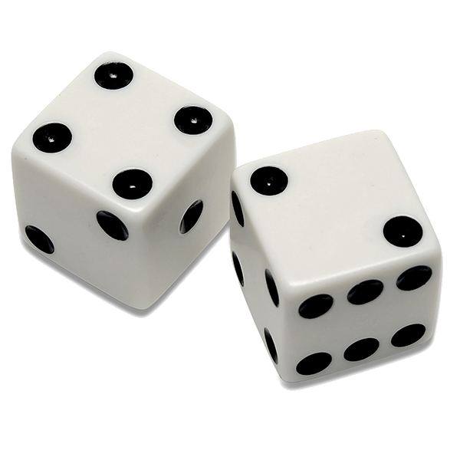
COUNTING RULES
procedure: 6 dice rolls
sample space: {111111, 111112, 111113, …211111, 211112, 211113,…655555, 655556,…666666}
46,656 simple events!
Our sample will be one of the following:
- A variation…
- A permutation…
- A combination…
…of simple events!
Notes:
Now we move on to counting. Discrete probability problems typically require that we know the total number of simple events in our sample space. If the sample space is relatively small, as was the case, for example, in throwing a dice once or twice or tossing a coin, we can simply enumerate all these simple events and count them manually. But the question is, what happens if the number of simple events is huge? You don't need to go far to look for examples of this.
For example, if our procedure involves rolling a dice 6 times, we get a sample space of over 45,000 events.
We need some more sensible way of counting the number of simple events in situations like this! Fortunately, there are rules for arrangements of simple events called variations, permutations, and combinations, which we’ll discuss in the next few minutes.

Slide 7

VARIATIONS (WITHOUT REPETITION)
- Set of n elements
- Experiment selects k elements one at a time without replacement.
- Each event = k elements in selected order
= k-variation without repetition of n elements
- Denoted by V_{n,k}
3rd
EXAMPLE
1st
There are 20 books – select 3 in the order we want to read them.
Each selection is a 3-variation without repetition of 20 elements = V_{20,3}
2nd
Notes:
Let’s start with ‘Variations without repetition’, which are defined in the following way. Suppose that you have a set of n elements, and our experiment consists of selecting k of these elements one at a time without replacement. And let's let each event consists of k elements in the order in which they are selected. Each of these events will then be called a K-variation without repetition of n elements and is denoted by Vn,k.. So variation without repetition of k elements over the set of n elements is simply selecting k elements of the set in a particular order. And none of the key elements can be repeated - we can select each element at most once.
As an example, let's say that we have 20 books and we want to choose three of them in the order in which we’re going to read them. Each selection of the books is a 3-variation without repetition over the set of 20 elements. We don’t choose the same book twice, and the order in which we choose our books matters to us, because it will determine the order in which we read them.

Slide 8

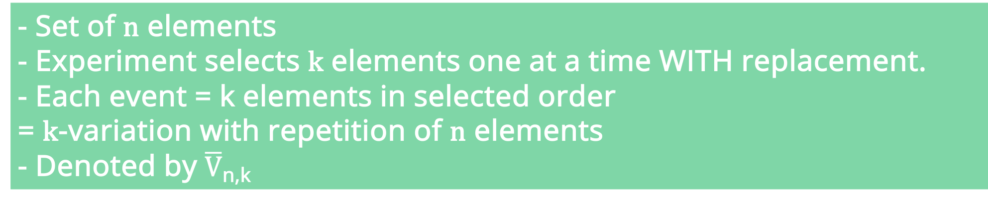
VARIATIONS (WITH REPETITION)
- Set of n elements
- Experiment selects k elements one at a time WITH replacement.
- Each event = k elements in selected order
= k-variation with repetition of n elements
- Denoted by $\overline{V}$_{n,k}
EXAMPLE
Rolling a dice 3 times
Each selection is a 3-variation with repetition of 6 elements = $\overline{V}$_{6,3}
Notes:
We also have variations with repetition, which are similar but different. Again, suppose that we have a set of n elements, and suppose that we need to choose k elements with replacement, which means that some of these elements can be repeated in our chosen subset. In this case, each event where we choose k elements in a particular order is called a K-variation with repetition over the set of n elements. This is denoted by V with a line above it, or V-bar. So again, the order matters, but in this case the uniqueness of the elements does not.
As an illustrative example, rolling a dice three times can be seen as choosing a random number between 1 and 6 three times, and recording the results. Whether or not the dice turns up the same number twice or even all three times doesn’t matter to us. Formally, we can define this as a 3-variation or over the set of six elements with repetition.
The main thing that variations with and without repetition have in common that the order matters. We’ll see the type of counting method for which it doesn’t matter shortly.

Slide 9
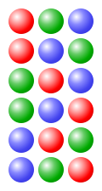
PERMUTATIONS
A permutation of n elements is a special case of k-variation without repetition of n elements where k = n
EXAMPLE
There are three balls in a bag (red, blue, and green) – we need to draw all three out of the bag at random
Each possible order is a permutation of 3 elements
Notes:
A special kind of variation without repetition is called a permutation. Permutation is simply a k-variation without repetition wherein the number of elements that we select is equal to the size of the set. So, formally, the permutation of n elements is a special case of k-variation without repetition of elements, where k equals n.
As an example, we have three coloured balls in a bag and for each procedure we draw all three balls out and record the order. This gives us the permutations of three elements illustrated on the slide here. The order still matters otherwise there’d be no way to distinguish one permutation from another.

Slide 10
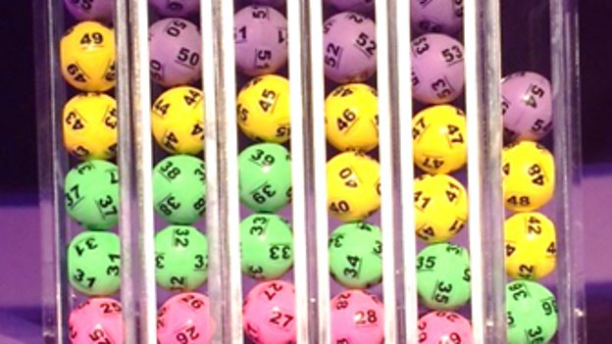
COMBINATIONS (WITHOUT REPETITION)
- Set of n elements
- Experiment selects k elements one at a time without replacement.
- Each event = k elements selected but the order does not matter
= k-combination without repetition of n elements
- Denoted by C_{n,k}
EXAMPLE
There are 59 balls in the National Lottery
Draw 6 numbers from this set and note their numbers - order of drawing does not matter
Lottery draw = C_{59,6}
Notes:
A combination is a type of enumeration of elements where the order does not matter. We’re going to look only at combinations without repetition. While combinations with repetition do exist, they are rarely used and so we can ignore them for now.
To define a combination, suppose that we have a set of n elements. Suppose also that our experiment consists of selecting k of the elements one at a time without replacement. Let each event consist of the k elements selected, where the order of selection does not matter. Each of these events is called a k-combination without repetition of n elements and denoted by Cn,k.
A concrete example of this which will likely be familiar to you is the lottery. In the UK National Lottery there are 59 balls, each with a distinct number from 1 to 59. In the lottery draw, 6 random balls are selected from this set and their numbers are recorded. The order of drawing does not matter – if you’ve got all 6 of those numbers, you’re going to be very happy no matter what order they were shown to you. Each drawing of all 6 balls is a 6-combination of 59 elements

Slide 11

USEFUL FORMULAE
The number of k-variations without repetition of n elements:
$$V_{n,k}=n⋅\left(n−1\right)⋅\left(n−2\right)…(n−k+1)$$
(note we have k factors in the above formula)
The number of k-variations with repetition of n elements:
$$V_{n,k}=n^{k}$$
The number of permutations of n elements:
$$P_{n}=n!$$
The number of k-combinations of n elements is
$$C_{n,k}= \left({n \atop k}\right)=\frac{n!}{k!⋅\left(n−k\right)!}=\frac{n⋅\left(n−1\right)…(n−\left(k+1\right))}{k!}$$
(note there are k factors in the numerator of the above fraction)
Notes:
This slide here gives the formulas for calculating the number of variations, permutations and combinations - with and without repetition.
By having these formulas available, it means that if we know n and k, we can just plug them into these formulas and know how many different simple events in our sample space there will be. And we are going to see in the next videos at least one or two applications of these for calculating the sizes of sample spaces.
The use of variations, permutation combinations in probability is mostly to calculate the sample space, and there are some guidelines of when each is most appropriate.
First, if the events in our sample space consist of repetition of the same results, and if the order does not matter, then we use combinations.
If the order of the result does matter and each result can appear only once, then we use the formula for variation without repetition. If the order of the results matters and each result can appear more than once, then you use variations with repetition.
One thing to note is that we have the factorial operator in a couple of these formulas, which is a number followed by an exclamation mark. All this means is that we take the number, and multiply it by itself minus 1, then itself minus 2, until we end up at 1. So 5 factorial is 5 * 4 * 3 * 2 * 1.

